Slide 1

ChocAn Data Center
Furqaan Attarwala
Vishal Chandra
Tanesh Manjrekar
Sufiyan Samnani
Notes:
NOTE:
To change the image on this slide, select the picture and delete it. Then click the Pictures icon in the placeholder to insert your own image.

Slide 2
Introduction

Slide 3
Project Summary
Purpose
Scope
Objectives
Deliverables

Slide 4
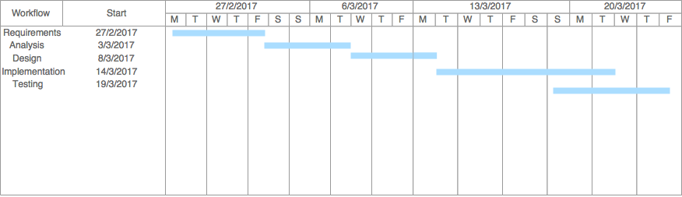
Schedule

Slide 5
Libraries
MigLayout
Apache Derby
Apache POI
JCalendar

Slide 6
Project Summary
Primary Roles & Responsibilities
Process Model

Slide 7
UML Diagrams

Slide 8
Functional Requirements
Validate Credentials
Insert Appointment Data
Validate Service Code
Generate Provider Directory
Generate Reports

Slide 9
Non-Functional Requirements
Performance
Availability
Recoverability
Security
Usability

Slide 10
Use Case

Slide 11
Provider Data Flow Analysis

Slide 12
Manager Data Flow Analysis

Slide 13
Class Diagram

Slide 14
CRC Cards
Initializer
LoginTerminal
ProviderTerminal
ManagerTerminal
Scheduler
MemberReport
ProviderReport
SummaryReport
DatabaseHelper

Slide 15
Provider Collaboration Diagram

Slide 16
Manager Collaboration Diagram

Slide 17
Provider Sequence Diagram

Slide 18
Manager Sequence Diagram

Slide 19
Database Design

Slide 20
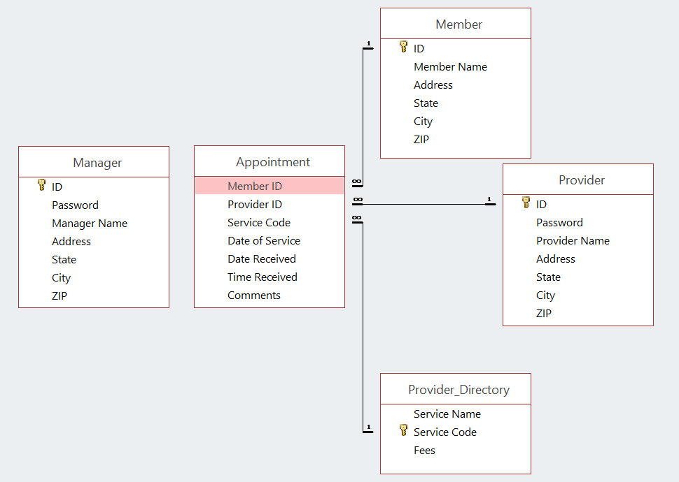
Entity Relationship Diagram

Slide 21
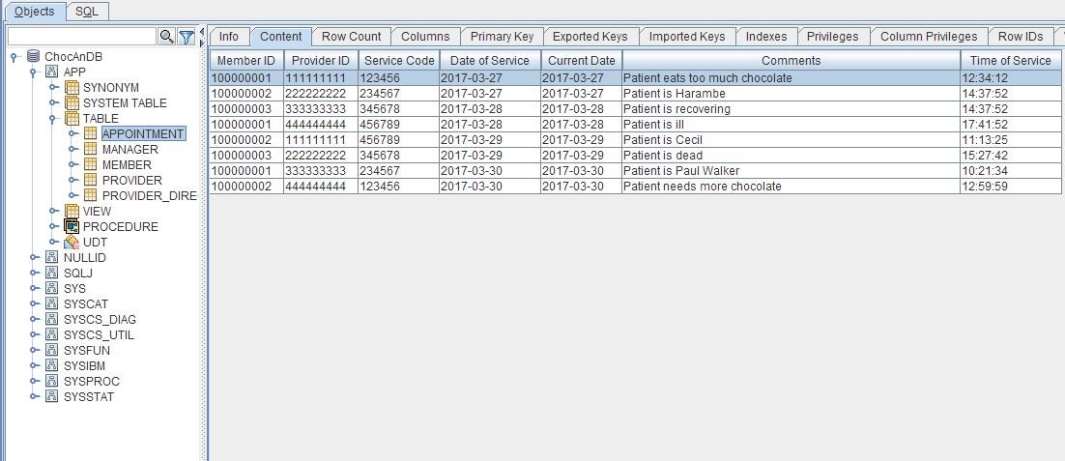
Appointment

Slide 22
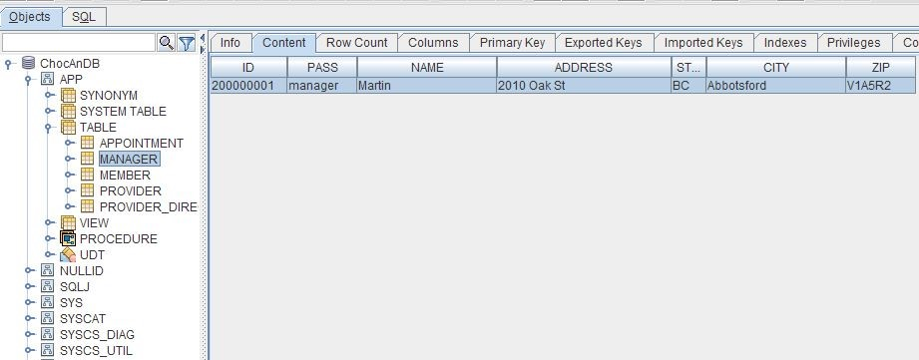
Manager

Slide 23
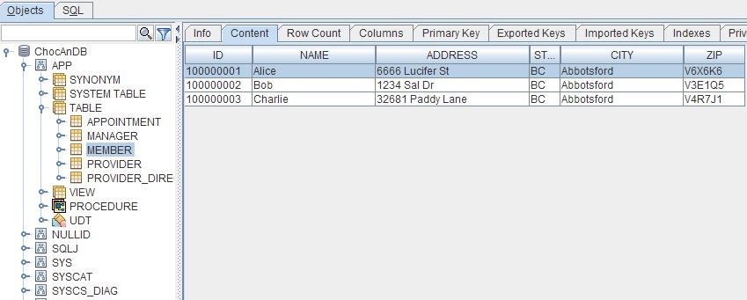
Member

Slide 24
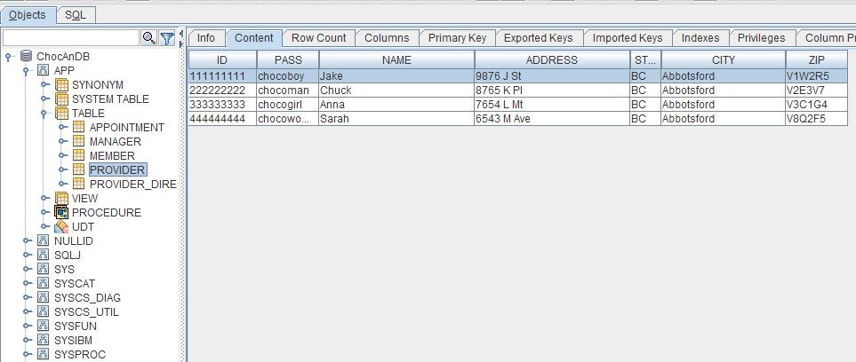
Provider

Slide 25
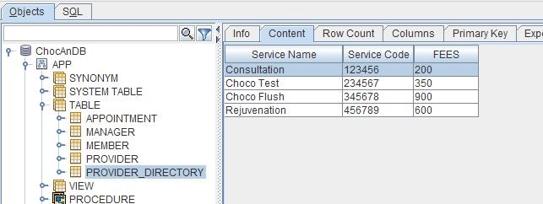
Provider Directory

Slide 26
Implementation & Testing

